Slide 1
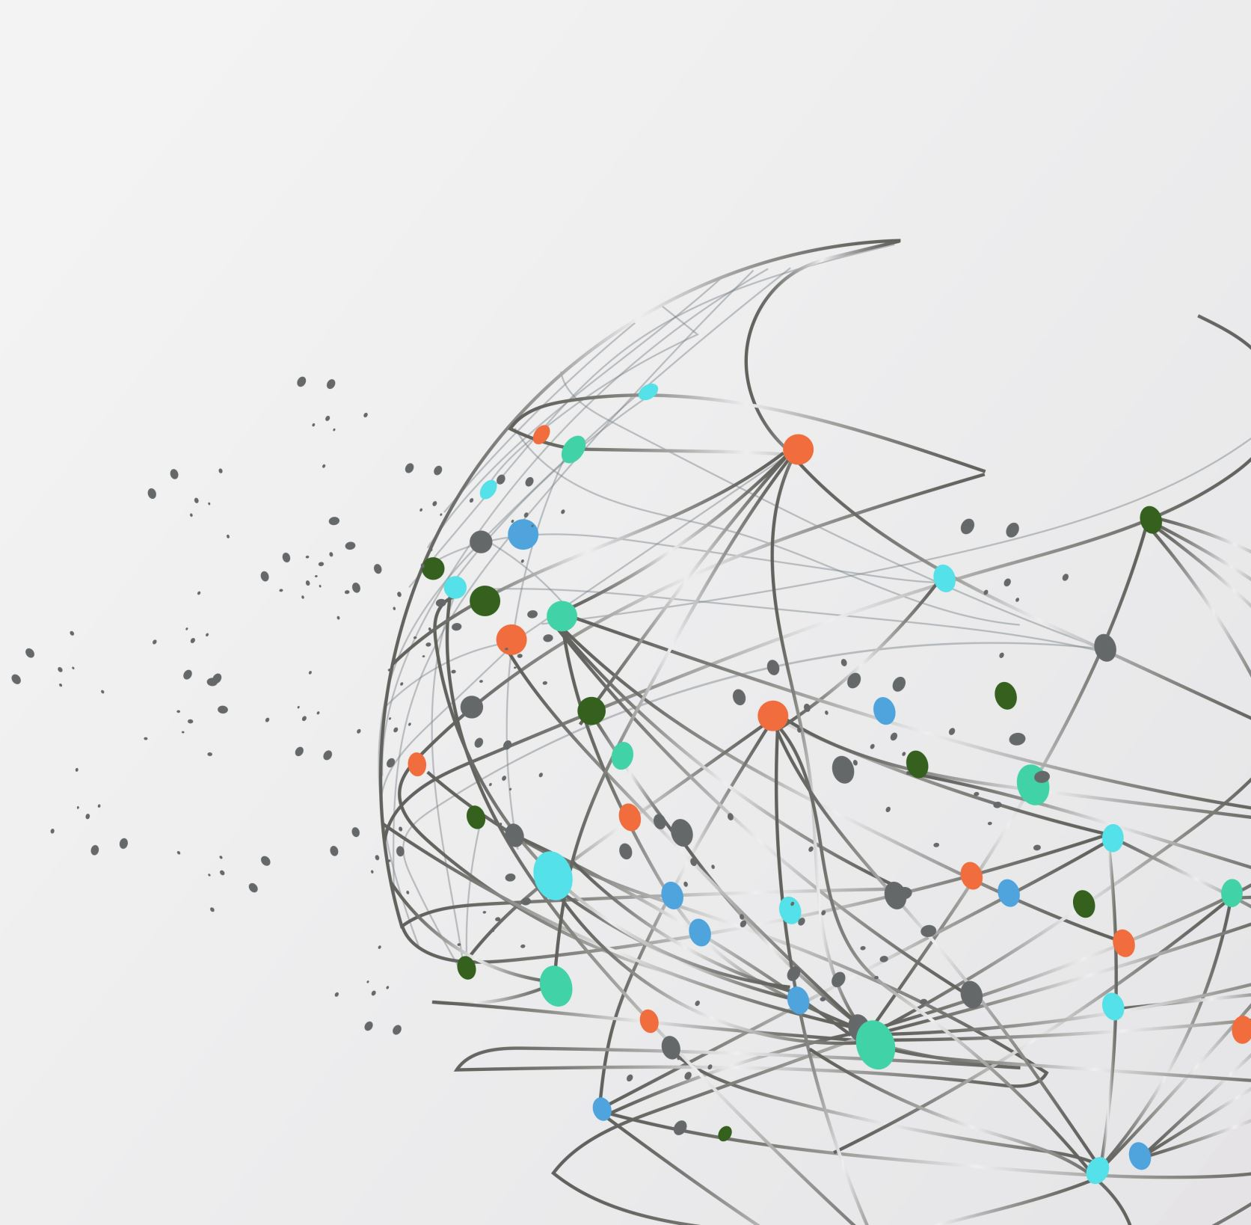
MODEL DEPLOYMENT ON FLASK
Mark kimutai kitur
kiturmark@gmail.com
LISUM33
21, Tuesday, May 2024

Slide 2

Steps of model deployment in flask
Build a machine model in Jupyter Notebook
Build HTML which will bring about appearance of the flask web app
Build flask app on python and deploy the model
Test the model on web browser.

Slide 3
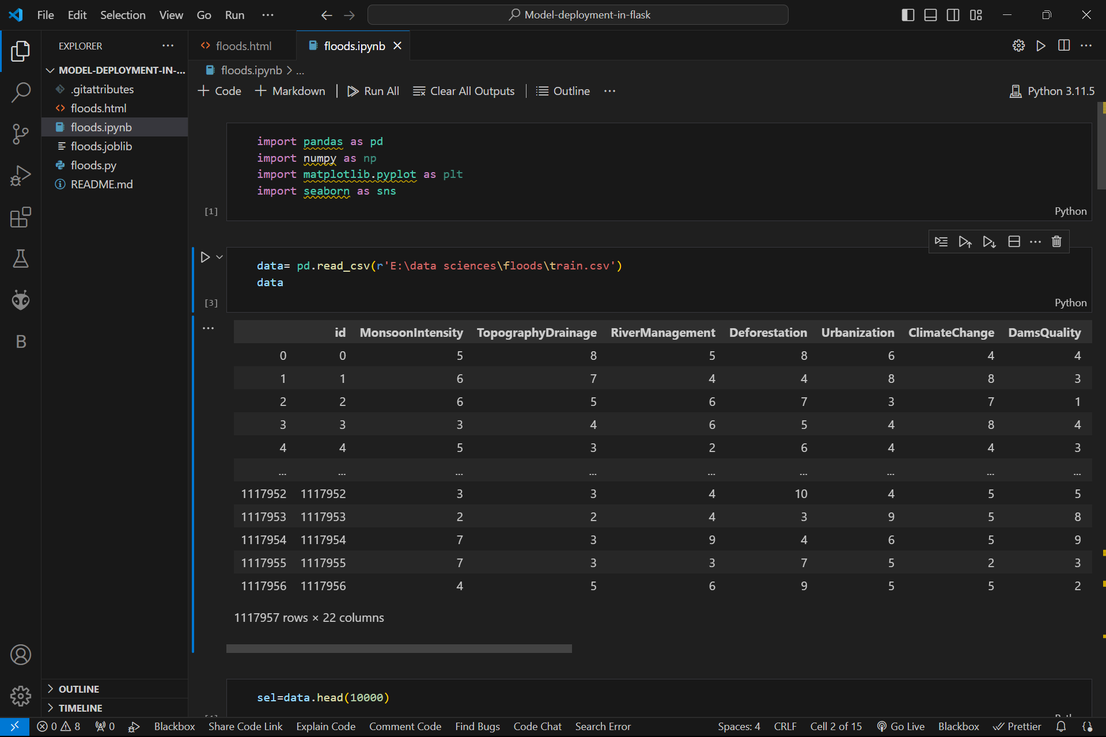
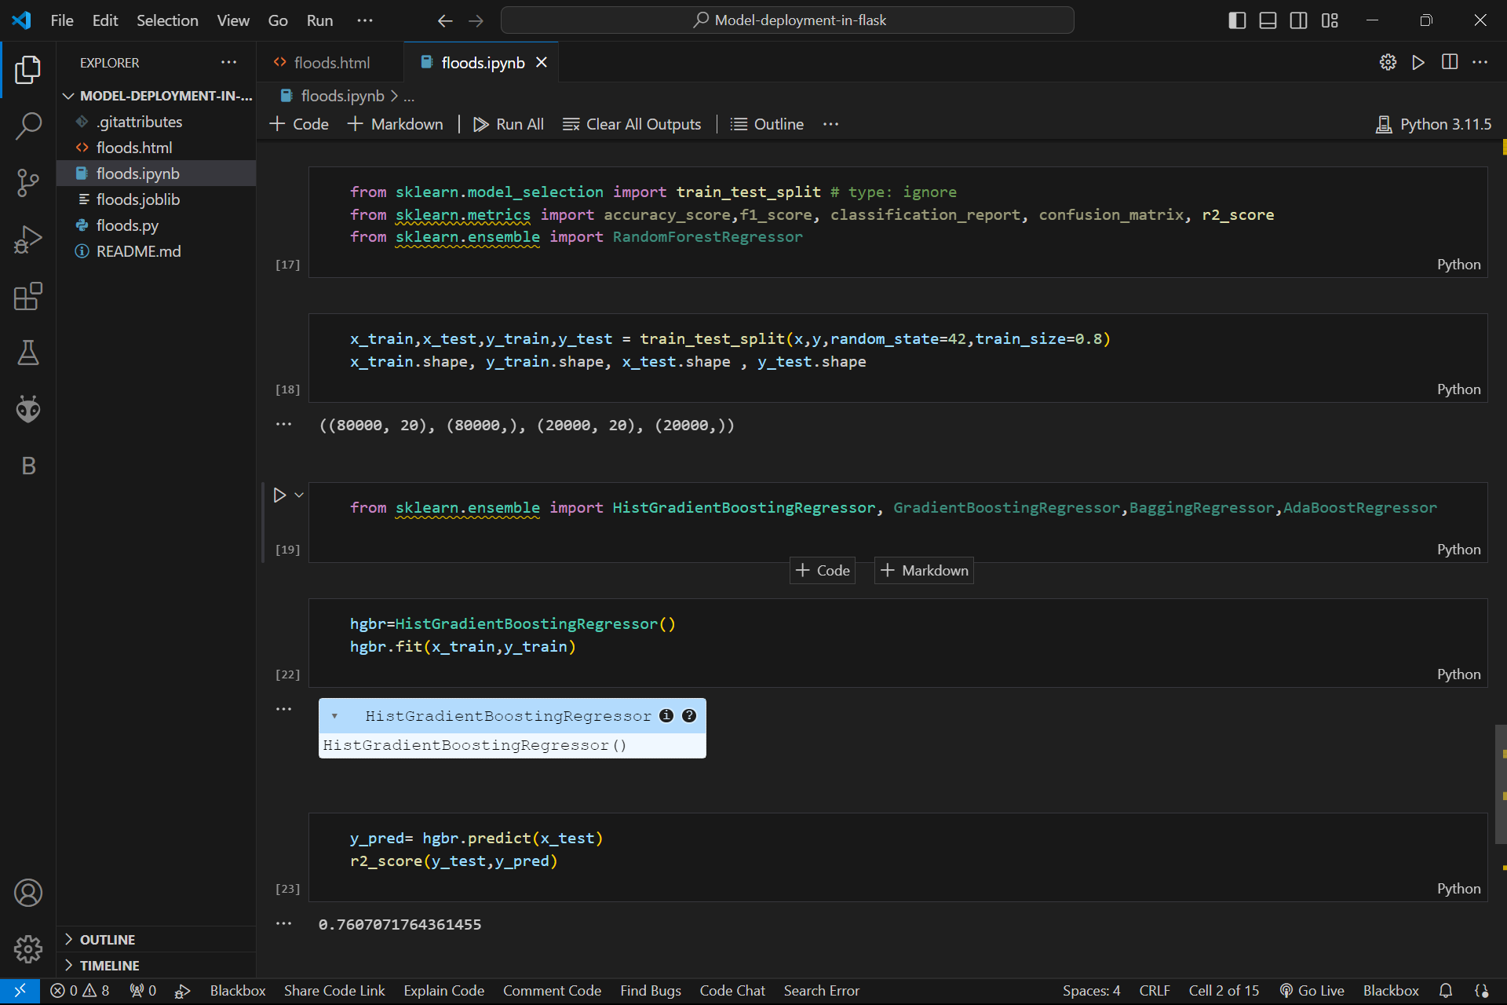
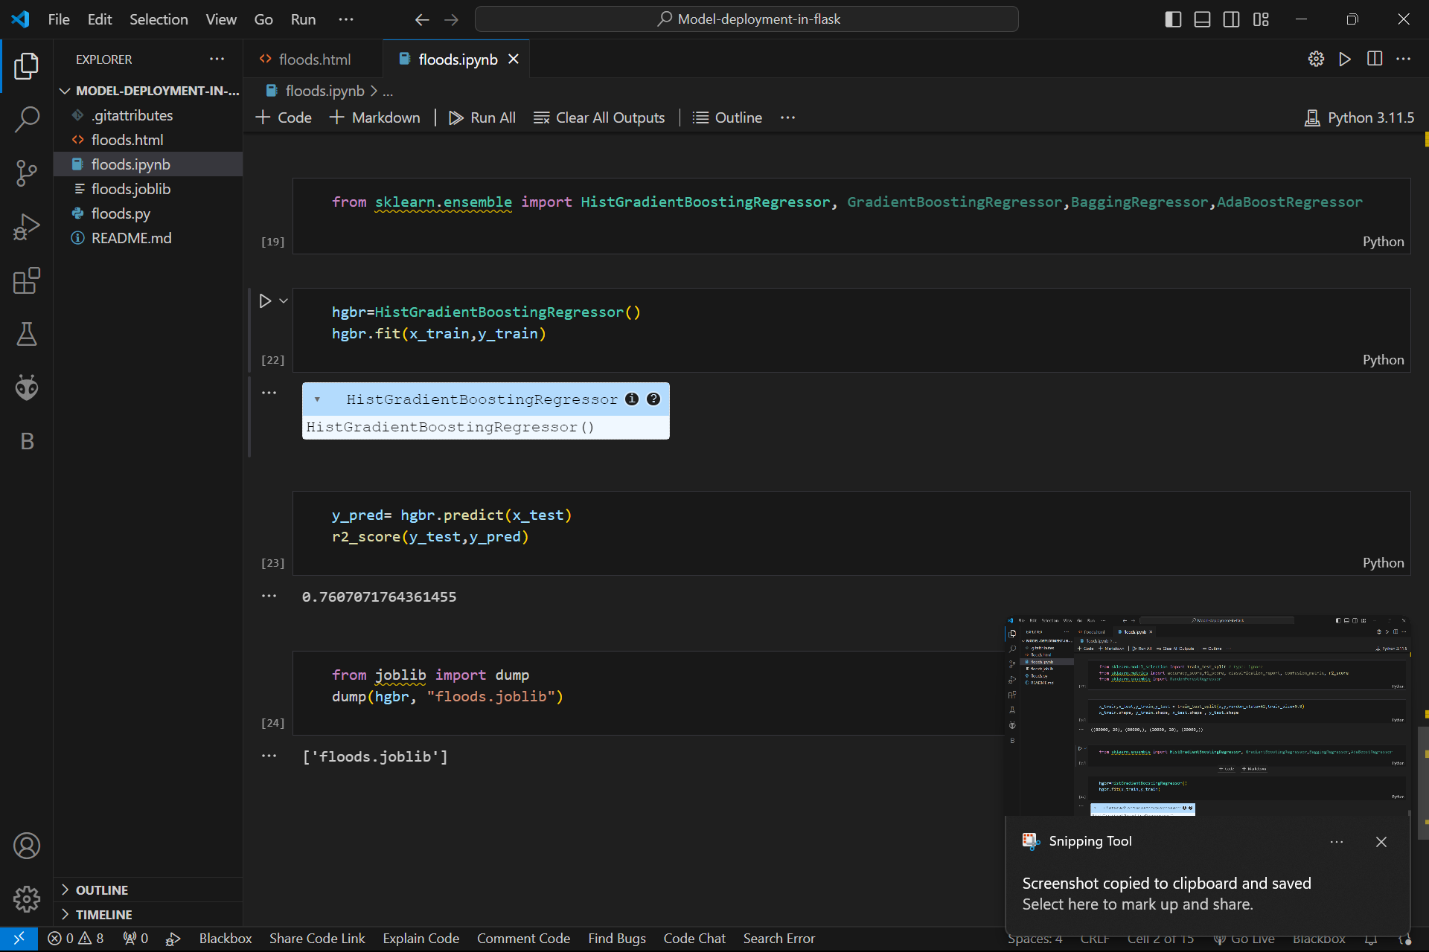
Building machine learning model
Import data
Data modeling and feature extraction
Split data
Training
Parameters tuning
Retraining
Save the model

Slide 4
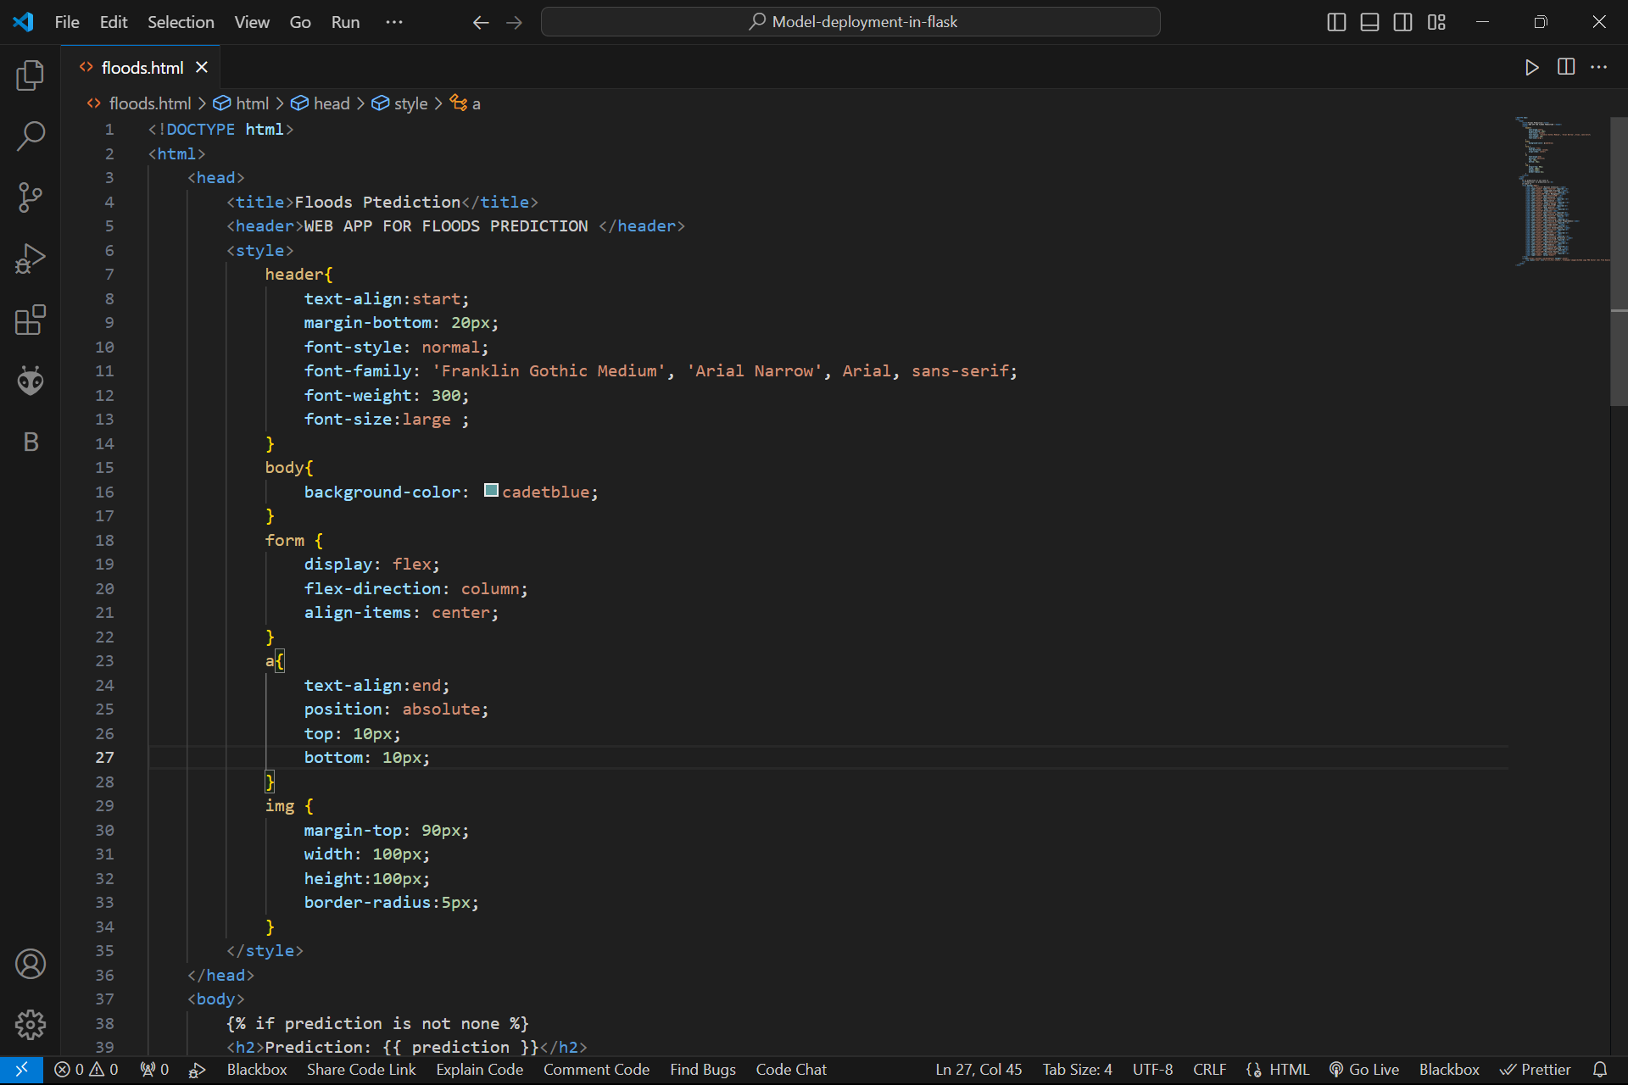
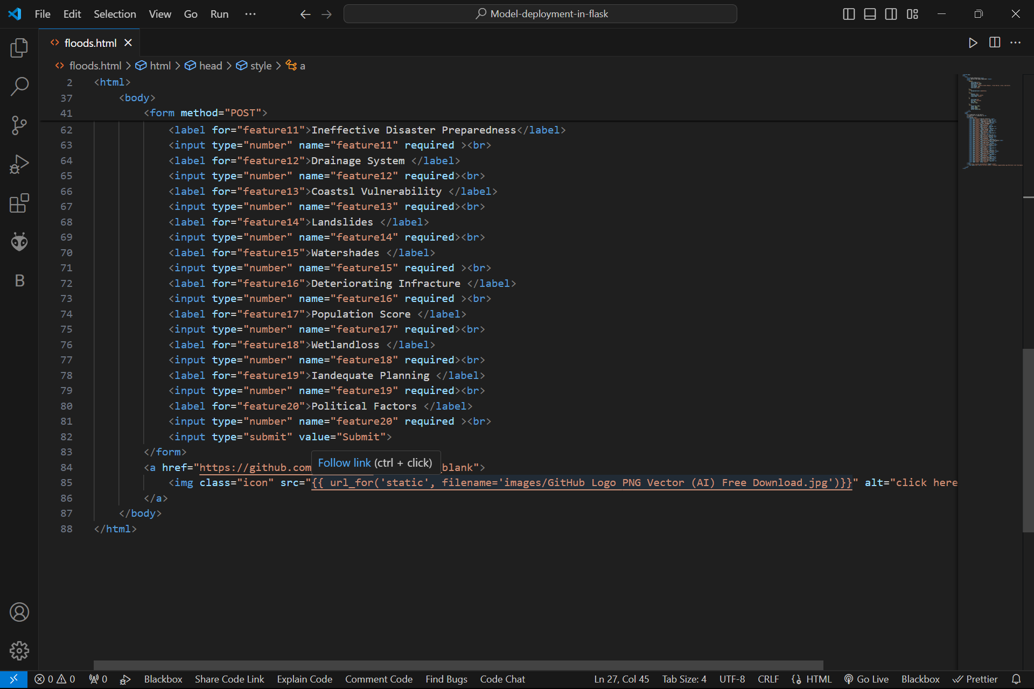
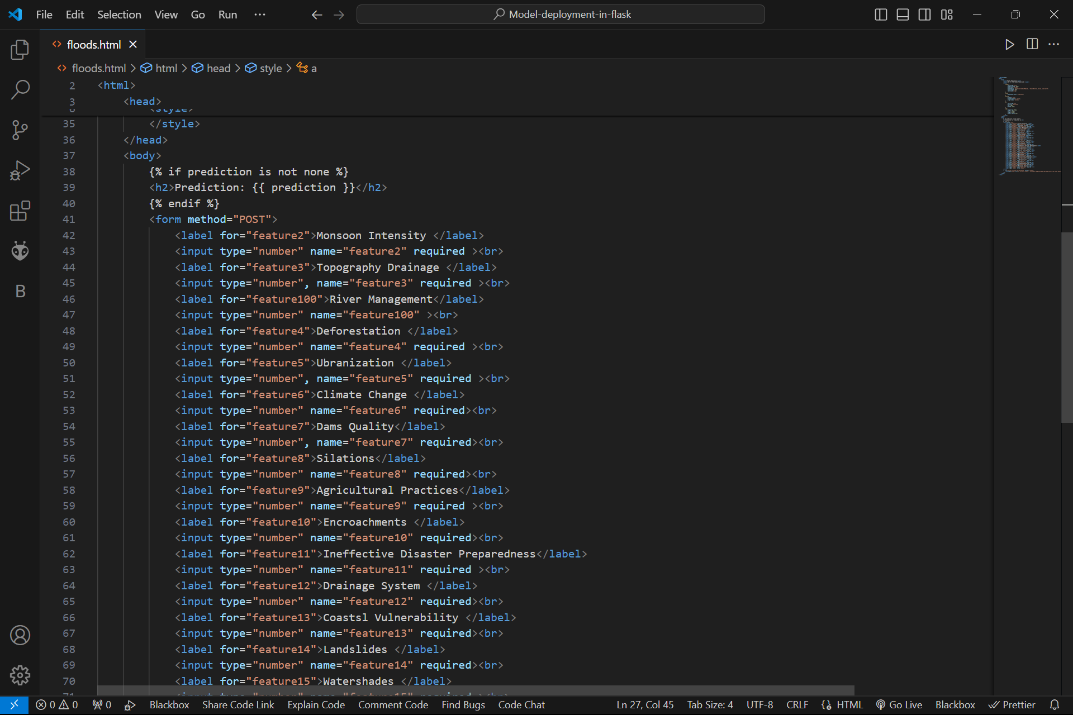
Building HTML
Make header and title of the web app
Create inputs for features
Make button for prediction

Slide 5
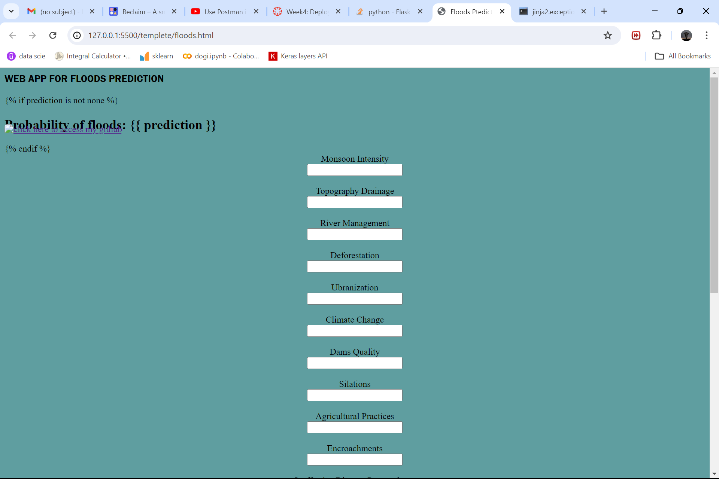

Slide 6
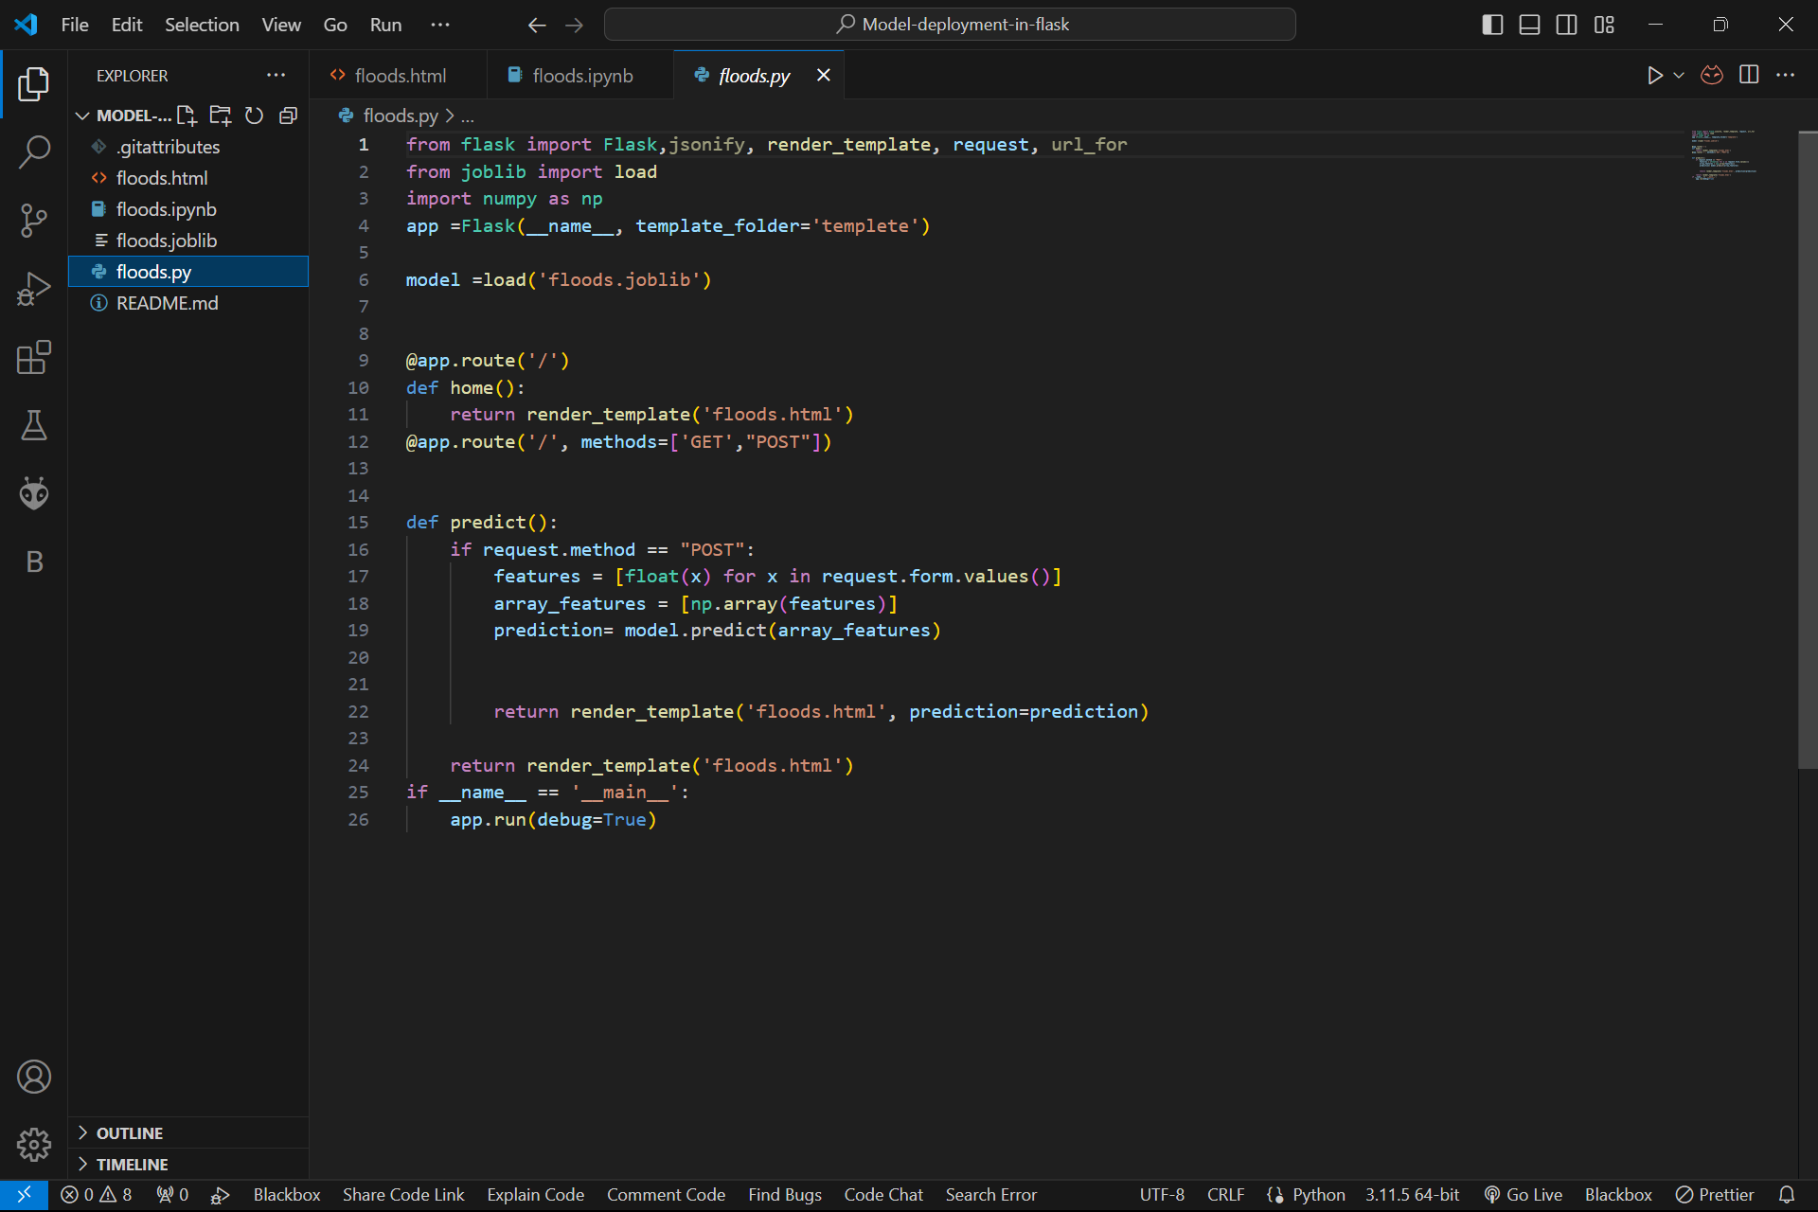
Building flask app
Import all necessary libraries
Instantiating app
Create a function for predicting

Slide 7
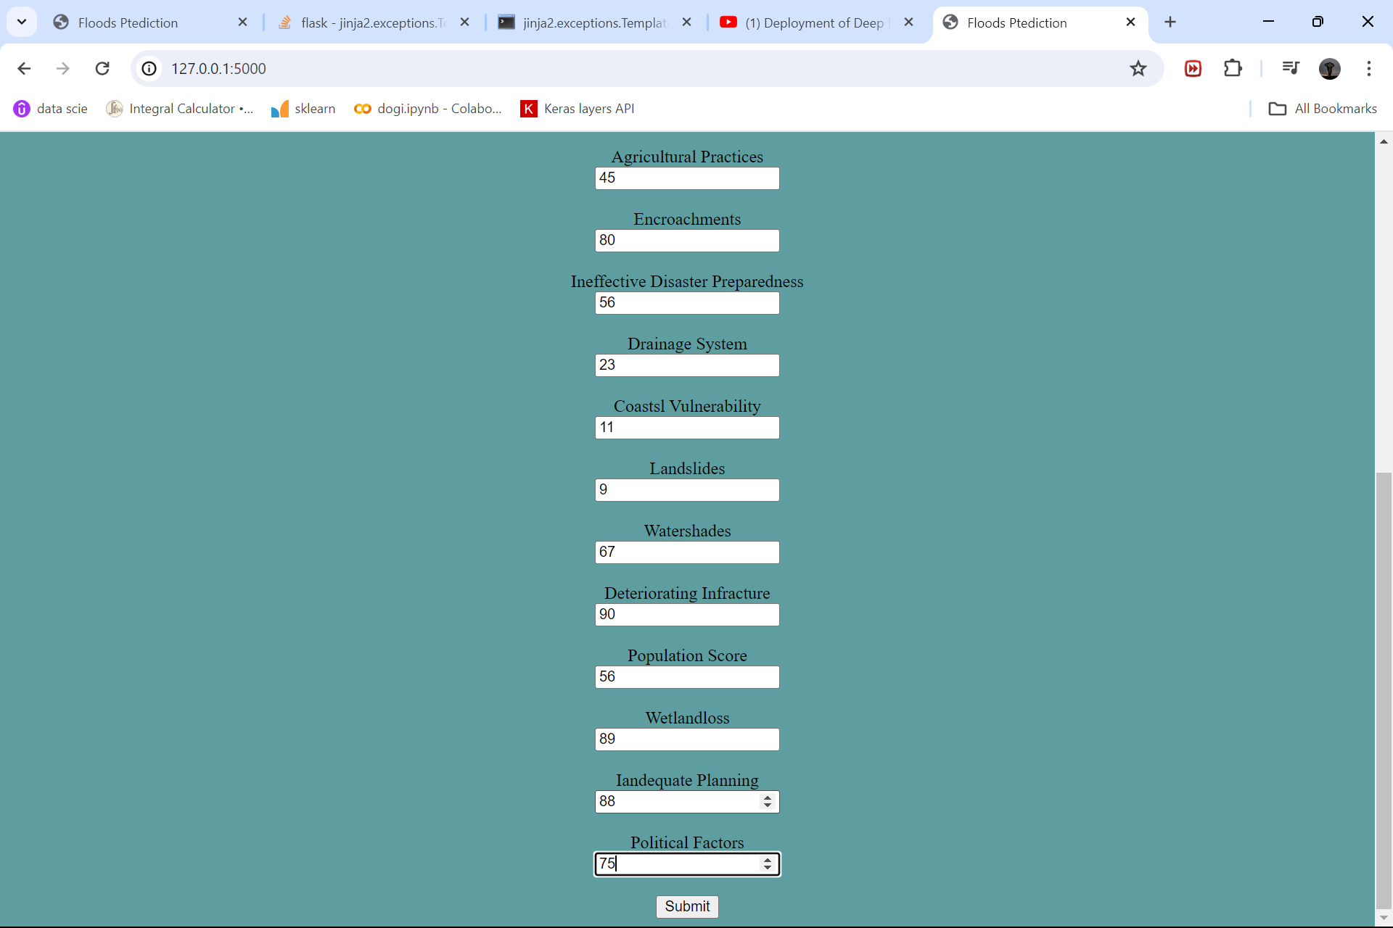
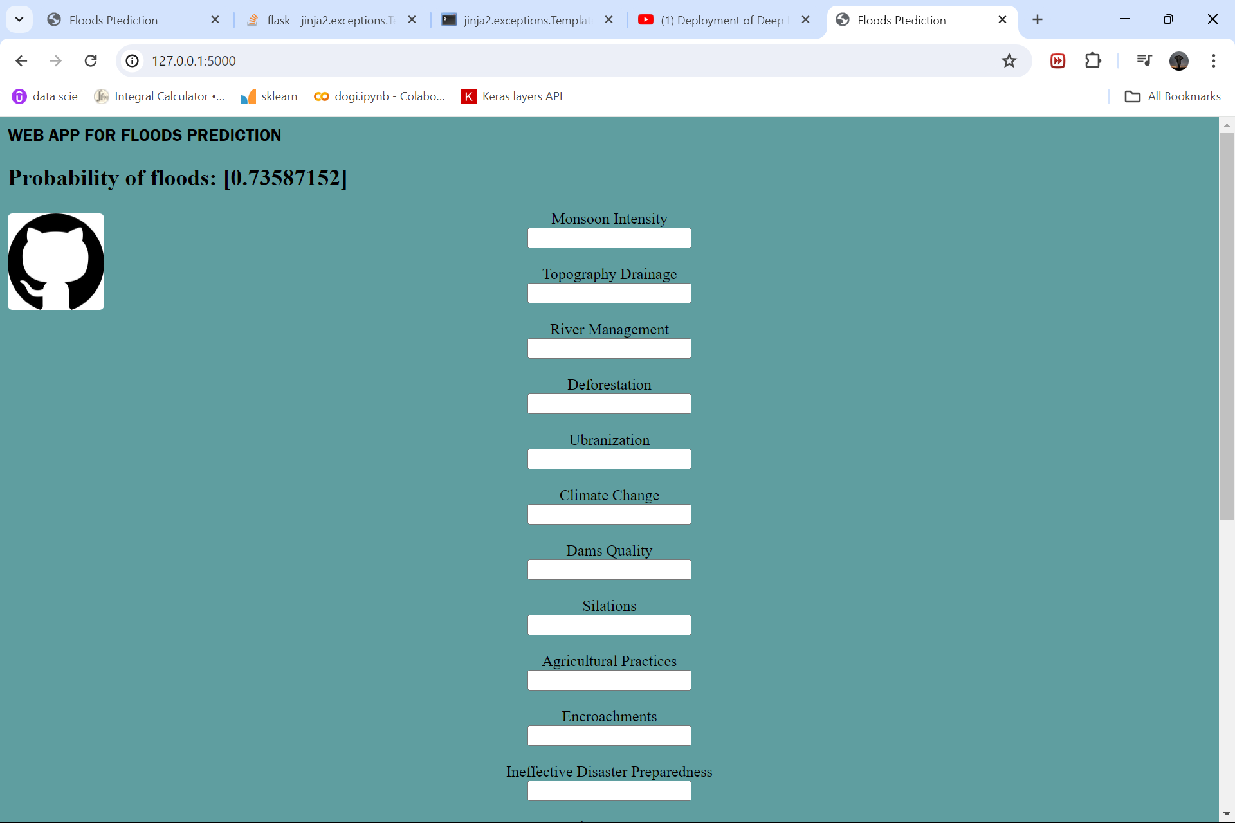
Before and after Prediction

